Slide 1






















Putting it all together
COURIER
REQUEST TRUST RECEIPT
Issue documents
Issue documents
3
19
19
4
LC ISSUANCE
ISSUING BANK
, 10
ADVISING BANK
7
, 13
LC acknowledgement
2
18
21
20
PAYMENT ADVISE
17
9
REQUEST BANKER’S GUARANTEE
, 11
REQUEST SHIPPING GUARANTEE
1
6
5
LC AMENDMENT
, 14
, 12
DOCUMENT ACCEPTANCE
8
Document presentation
LC APPLICATION
Authorize LC ADVISING
NOTIFICATION
LC ADVISING
IMPORTER
EXPORTER
CERT OF ORIGIN
16
CHAMBER OF COMMERCE
GOODS
23
15
GOODS
22
PRESENT BILL OF LADING
Bill of lading, shipping manifest
CARRIER
CERT OF INSURANCE
INSURANCE
16
16

Slide 2

importerUserName

Slide 3

Importer
Logout
Tech Pte Ltd
Add New Contract
Contract ID | Description | Exporter | Advising Bank | Issuing Bank | LC Status
1237253 | 2000 Earphone | Manufact Pte Ltd | ABC Bank | EFG Bank
2353332 | 2500 Batteries | Create Pte Ltd | AAA Bank | EFG Bank | Pending
6373894 | 1800 USB Wire | One Pte Ltd | DHD Bank | EFG Bank
Apply
View
View
PDF
View

Slide 4
Importer
Logout
Request for LC
Shipment ID:
Content Description:
Value:
Importer Company
Issuing Bank:
Remarks:
Freight Company:
Location Port Origin:
Location Port Destination:
Submit
Reset

Slide 5
Issuing Bank
Logout
Contract : 1237253
Shipment ID:
7736
Content Description:
2000 Earphones
Importer
Issuing Bank
Advising Bank
Exporter
Value Worthiness:
26238
Importer Company
Manufact Pte Ltd
Advising Bank:
ABC Bank
Freight Company:
Shipnow Pte Ltd
Location Port Origin:
US
Location Port Destination:
China
Home

Slide 6
issueBankUser

Slide 7
Issuing Bank
Logout
Contract ID | Description | Request from(Importer) | Exporter | Advising Bank | Status
1237253 | 2000 Earphone | Tech Pte Ltd | Manufact Pte Ltd | ABC Bank | Pending
2353332 | 2500 Headset | Energy Pte Ltd | ABC Bank | ABC Bank | Approve
View
View

Slide 8
Issuing Bank
Logout
Contract : 1237253
Shipment ID:
7736
Content Description:
2000 Earphones
Importer
Issuing Bank
Advising Bank
Exporter
Value Worthiness:
26238
Importer Company
Manufact Pte Ltd
Advising Bank:
ABC Bank
Freight Company:
Shipnow Pte Ltd
Location Port Origin:
US
Location Port Destination:
China
Approve
Reject

Slide 9
Exporter
Logout
Generate Letter of Credit
Letter of Credit:
/ABC_PTE_LTD_LetterOfCredit
Browse…
View
Upload
Home

Slide 10
advisingBankUser

Slide 11
Advising Bank
Logout
Contract ID | Description | Request from(Importer) | Exporter | Issuing Bank | Status
1237253 | 2000 Earphone | Tech Pte Ltd | Manufact Pte Ltd | ABC Bank | Pending
2353332 | 2500 Headset | Energy Pte Ltd | ABC Bank | ABC Bank | Approve
View
View

Slide 12
Advising Bank
Logout
Contract : 1237253
Shipment ID:
7736
Letter of Credit:
View
Content Description:
2000 Earphones
Insurance Documents:
View
Value Worthiness:
26238
Importer
Issuing Bank
Advising Bank
Exporter
Importer Company
Manufact Pte Ltd
Advising Bank:
ABC Bank
Freight Company:
Shipnow Pte Ltd
Location Port Origin:
US
Location Port Destination:
China
Approve
Reject

Slide 13
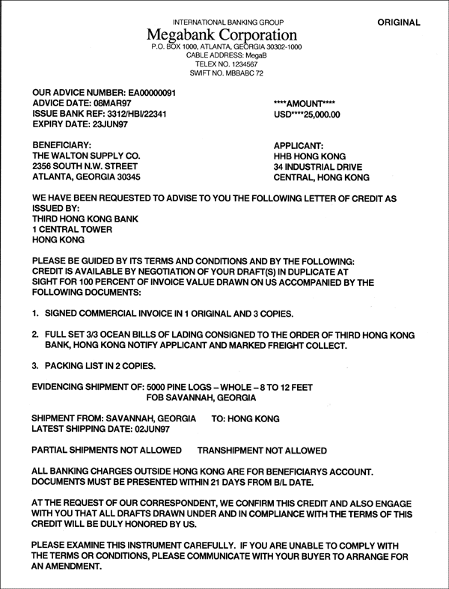
Advising Bank
Logout
Letter of Credit
Back

Slide 14
ExporterUserName

Slide 15
Exporter
Logout
Add New Contract
Contract ID | Description | Customer(importer) | Advising Bank | Issuing Bank | Status
1237253 | 2000 Earphone | Tech Pte Ltd | ABC Bank | EFG Bank | Pending
2353332 | 2500 Headset | Energy Pte Ltd | ABC Bank | CDE Bank | Pending
View
View

Slide 16
Exporter
Logout
Contract : 1237253
Shipment ID:
7736
Letter of Credit:
View
Content Description:
2000 Earphones
Insurance Documents:
View
Value Worthiness:
26238
Importer
Issuing Bank
Advising Bank
Exporter
Importer Company
Manufact Pte Ltd
Advising Bank:
ABC Bank
Freight Company:
Shipnow Pte Ltd
Location Port Origin:
US
Location Port Destination:
China
Approve
Reject

Slide 17
Exporter
Logout
Contract : 1237253
Shipment ID:
7736
Letter of Credit:
View
Content Description:
2000 Earphones
Insurance Documents:
View
Value Worthiness:
26238
Importer Company
Manufact Pte Ltd
Advising Bank:
ABC Bank
Remarks:
Freight Company:
Shipnow Pte Ltd
Location Port Origin:
US
Location Port Destination:
China
Submit
Cancel

Slide 18
Exporter
Logout
Upload Bill of Lading
Bill of Lading:
/ABC_PTE_LTD_LetterOfCredit
Browse…
View
Upload
Home

Slide 19
Importer
Logout
Tech Pte Ltd
Add New Contract
Contract ID | Description | Exporter | Advising Bank | Issuing Bank | LC Status
1237253 | 2000 Earphone | Manufact Pte Ltd | ABC Bank | EFG Bank
2353332 | 2500 Batteries | Create Pte Ltd | AAA Bank | EFG Bank | Pending
6373894 | 1800 USB Wire | One Pte Ltd | DHD Bank | EFG Bank
PDF
View
View
PDF
View

